Slide 1
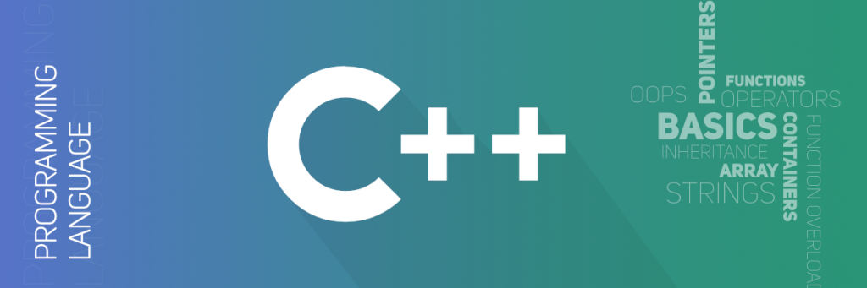

Slide 2

What is the basic structure of a C++ program?
Structure of a C++ program
A C++ program is structured in a specific and particular manner. In C++, a program is divided into the following three sections:
Standard Libraries Section
Main Function Section
Function Body Section

Slide 3
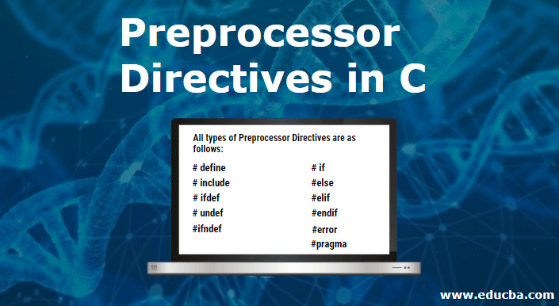
C++ PREPROCESSOR
The preprocessors are the directives, which give instructions to the compiler to preprocess the information before actual compilation starts.
All preprocessor directives begin with #, and only white-space characters may appear before a preprocessor directive on a line. Preprocessor directives are not C++ statements, so they do not end in a semicolon (;).
You already have seen a #include directive in all the examples. This macro is used to include a header file into the source file.
There are number of preprocessor directives supported by C++ like #include, #define, #if, #else, #line, etc.

Slide 4
There are 4 Main Types of Preprocessor Directives:
Macros
File Inclusion
Conditional Compilation
Other directives
Let us now learn about each of these directives in detail.
1. Macros
Macros are pieces of code in a program that is given some name. Whenever this name is encountered by the compiler, the compiler replaces the name with the actual piece of code. The ‘#define’ directive is used to define a macro.

Slide 5
2. File Inclusion
This type of preprocessor directive tells the compiler to include a file in the source code program.
3. Conditional Compilation
Conditional Compilation directives are a type of directive that helps to compile a specific portion of the program or to skip the compilation of some specific part of the program based on some conditions. This can be done with the help of the two preprocessing commands ‘ifdef‘ and ‘endif‘.
4. Other Directives
Apart from the above directives, there are two more directives that are not commonly used. These are:
#undef Directive

Slide 6
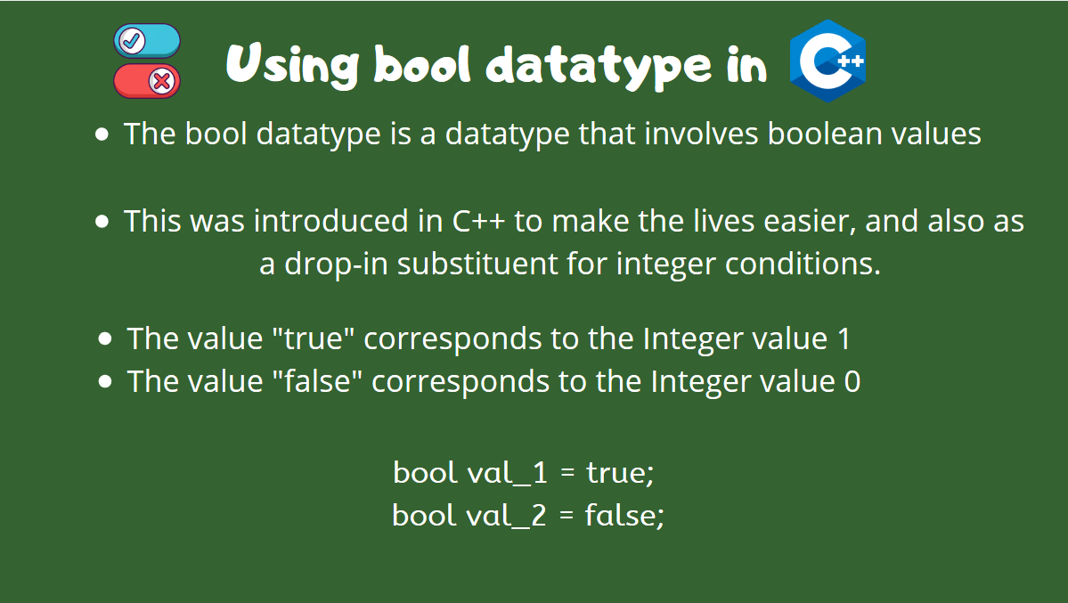
Bool data type in C++
The ISO/ANSI C++ Standard has added certain new data types to the original C++ specifications.They are provided to provide better control in certain situations as well as for providing conveniences to C++ programmers.
One of the new data type is: bool
Syntax:
bool b1 = true; // declaring a boolean variable with true value

Slide 7


